Slide 1

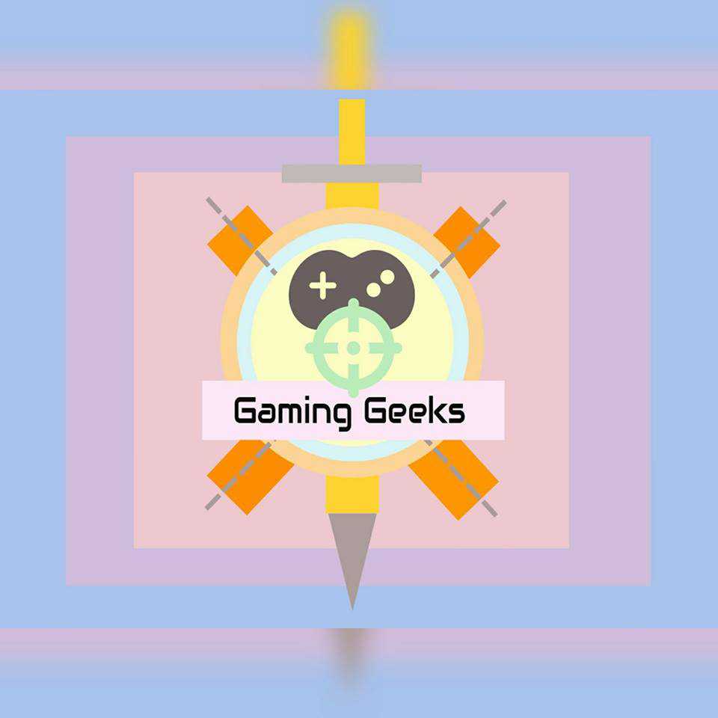
Game Design
Using unity 3D Game engine

Slide 2
Introduction
Unity 3D is a cross-platform 3D game engine. That is an important problem of seeking the road in the process of game production. The main solution is path-finding algorithm in which the player finds a path to the target in game scene. In this project, by general path-finding game scene as background, we focus on the A* algorithm and “Navmesh Grid” path-finding in Unity 3D, and put forward the improvement and application of algorithm in the special game scene.
Unity 3D is a comprehensive game development tool which is developed by Unity Technologies. Most games in the process of production will encounter the problem of seeking the road. How to try to find a path that from the starting point to the target point in game map? More complex games also needs to consider the file structure of the game map and the passable of target location etc. In this project, we focus on the two common path-finding algorithm in Unity 3D, and put forward the improvement and application of algorithm in the special game scene.

Slide 3
Introduction
Navmesh Grid” Path-Finding
“Navmesh grid” path-finding is a path-finding algorithm integrated in the Unity 3D, only need to set up the map and add “Navmesh Agent” component for players. Component is the basic unit of the material form in the Unity 3D. A basic component of an object includes a mobile component, a grid component, and rendering. The position of the object can be controlled by moving the component, the shape of an object can be created by the grid component, and the material of the object can be rendered by the rendering component. Build a player who can find the way through different component.
A* Algorithm
A* algorithm is the most widely used in the game map, which uses the heuristic function to estimate the distance of any point to the target point, so as to reduce the search space and improve the search efficiency. A∗ algorithm is a heuristic search algorithm based on “Dijkstra” algorithm. Heuristic search is searching to evaluate each extension node in the state space, and select the best node's location, and then search from the start node until it finds the target node. In heuristic search, the location of the evaluation is very important, and the use of different evaluation may have different effects. The valuation function represents the estimated cost of moving from the current node to the target node, which is heuristic. In the path-finding and maze problem, we usually use the Manhattan estimation function to estimate the cost.

Slide 4
Literature review
TOPIC : Path-finding Using Unity 3D
OVERVIEW :

Slide 5
Requirements
Algorithms
Unity
Game Engine
3D Modelling
Software

Slide 6
Technology used
Unity Platform
Unity is a game development platform that consists of a game engine and graphical user interface called the Unity Editor. Unity was originally created in 2005 to enable developers to make video games and to help make the video game Goo Ball. Since then, Unity has grown and is now used by a large community of game developers to make a variety of interactive simulations, ranging from small mobile and browser-based games to high-budget console games and AR/VR experiences. This historical focus on developing a general-purpose engine to support a variety of platforms, developer experience levels, and game types make the Unity engine an ideal simulation platform.
The ﬂexibility of the underlying engine makes everything from simple grid world problems to complex strategy games, physics-based puzzles, or multi-agent competitive games possible. Unlike many of the research platforms deﬁned above, the underlying engine is not restricted to any speciﬁc genre of gameplay or simulation. Furthermore, the Unity Editor enables rapid prototyping and development of games and simulation environments.

Slide 7
Technology used
Unity Terminology
A Unity Project consists of a collection of Assets. These typically correspond to ﬁles within the Project. Scenes are a special type of Asset which deﬁne the environment or level of a Project.
Scenes contain a deﬁnition of a hierarchical composition of Game Objects, which correspond to the actual objects, either physical or purely logical, within the environment. The behaviour and function of each Game Object is determined by the components attached to it.
There are a variety of built-in components provided with the Unity Editor, including Cameras, Meshes, Renderers, Rigid Bodies, and many others. It is also possible to deﬁne custom components using C# scripts or external plugins.

Slide 8
Thank You

